Slide 1



Enjoy your stylish business and campus life with BIZCAM
5조

Slide 2


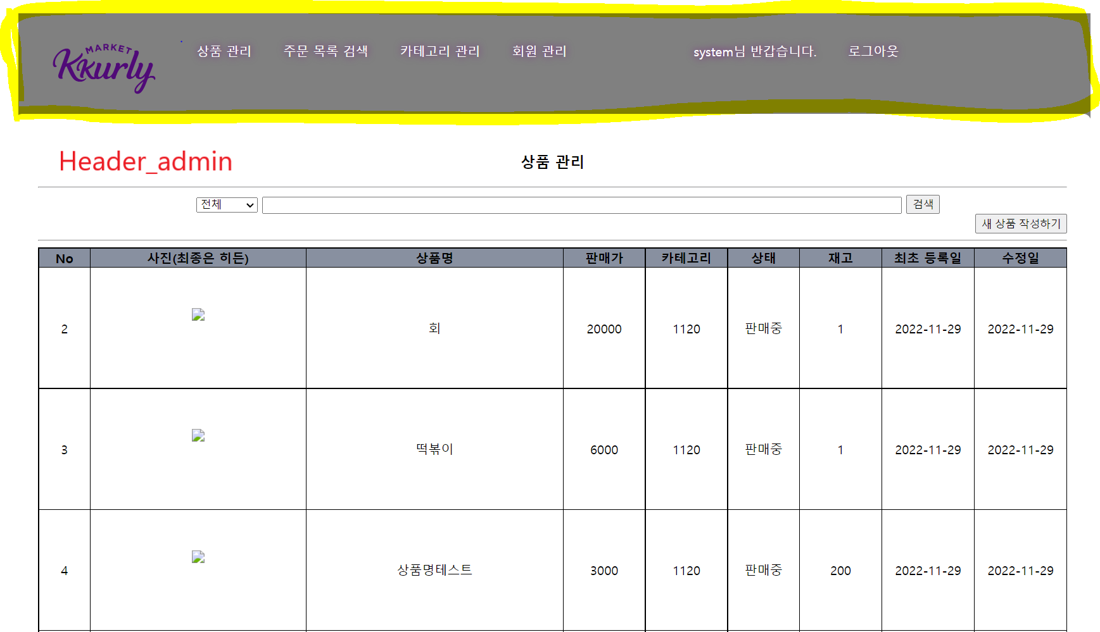
Enjoy your stylish business and campus life with BIZCAM

Slide 3
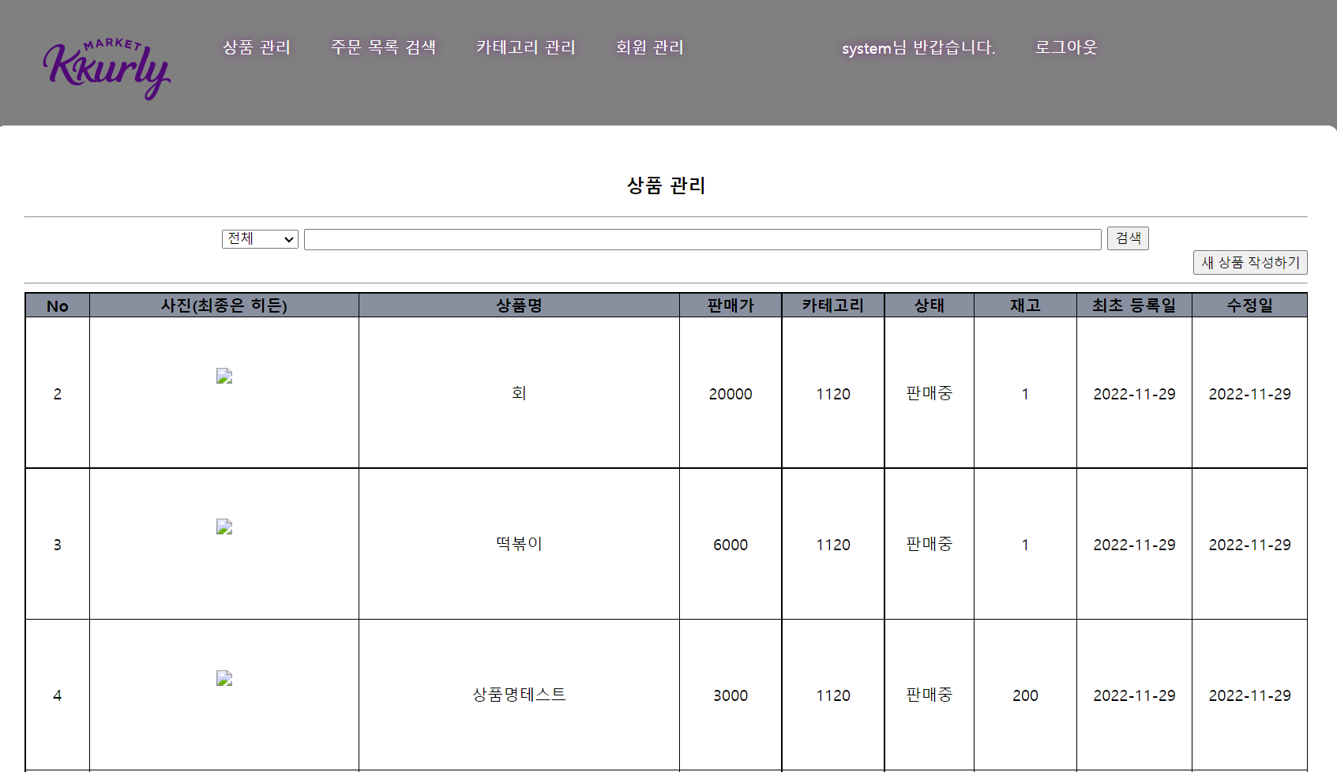
Enjoy your stylish business and campus life with BIZCAM

Slide 4
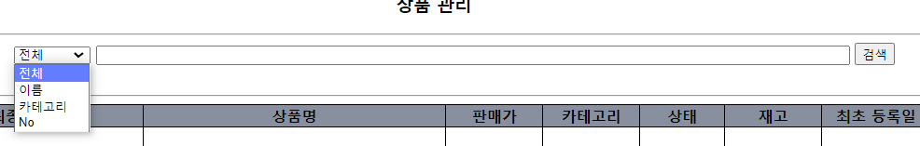
Enjoy your stylish business and campus life with BIZCAM

Slide 5
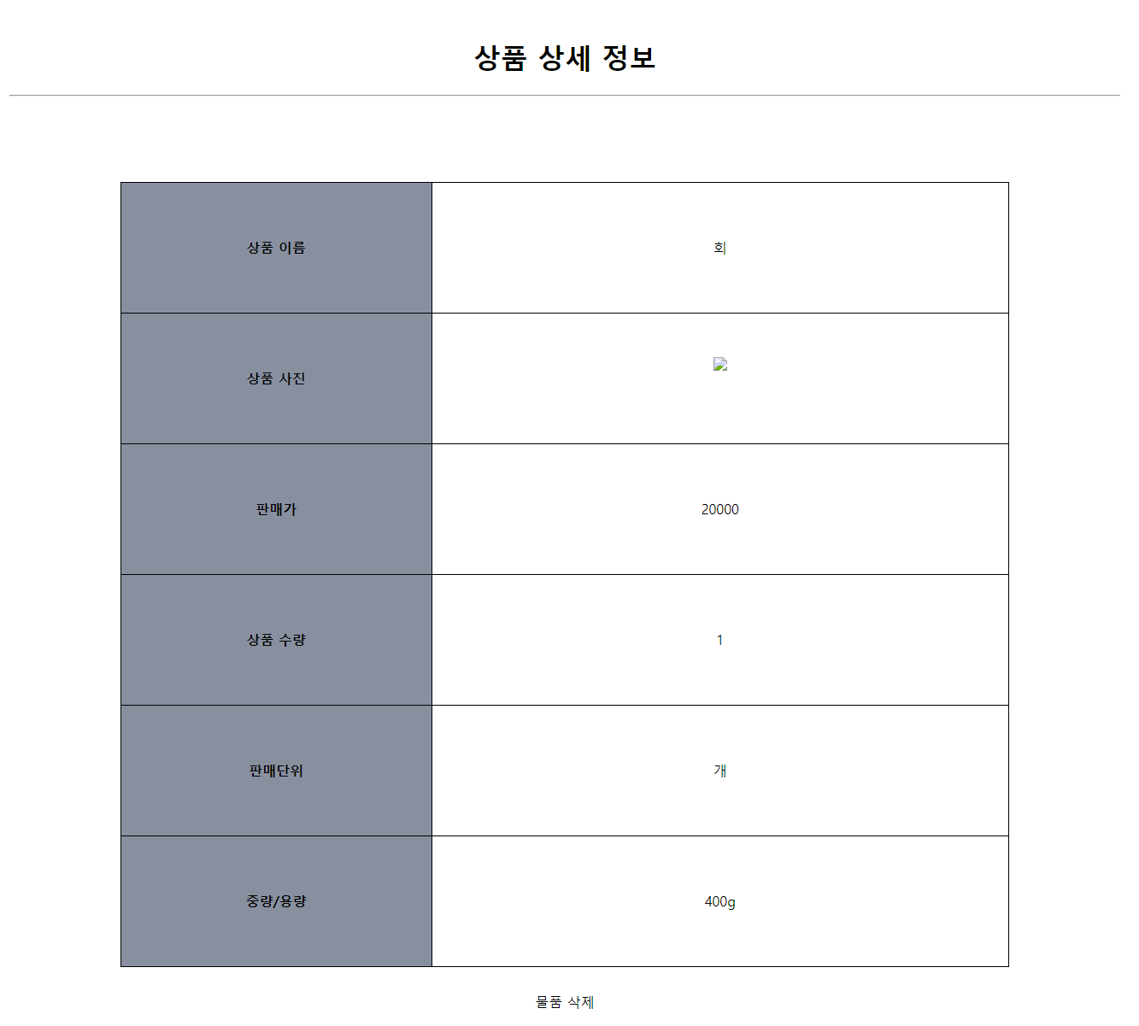
Enjoy your stylish business and campus life with BIZCAM

Slide 6
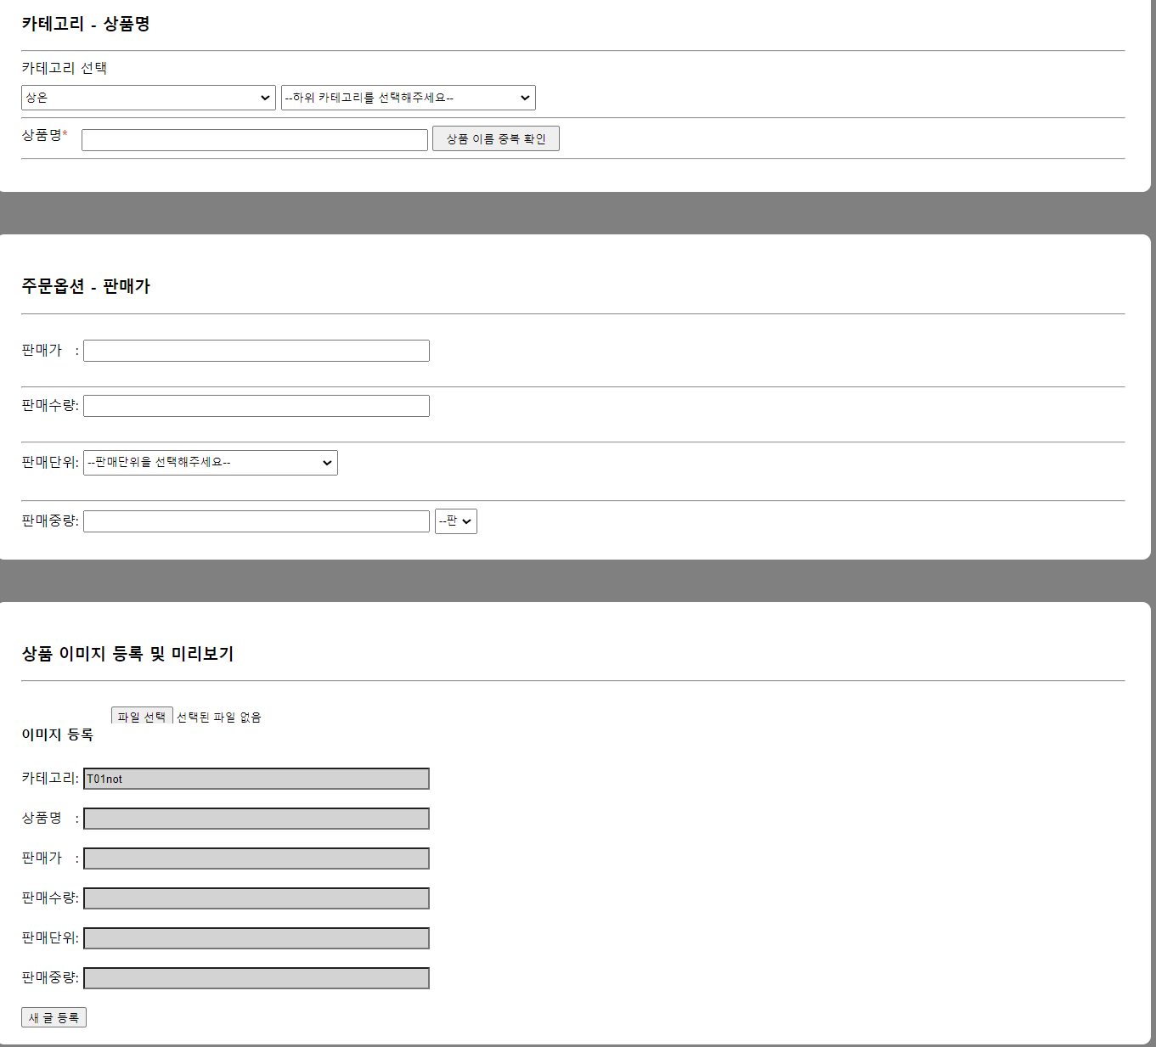
Enjoy your stylish business and campus life with BIZCAM

Slide 7
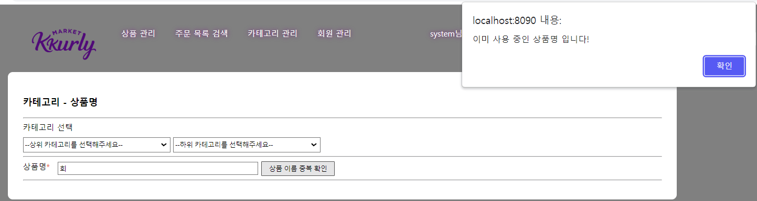
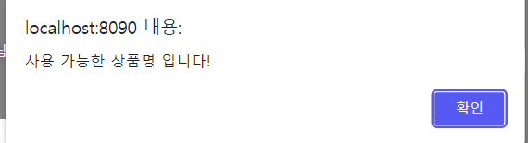
Enjoy your stylish business and campus life with BIZCAM

Slide 8
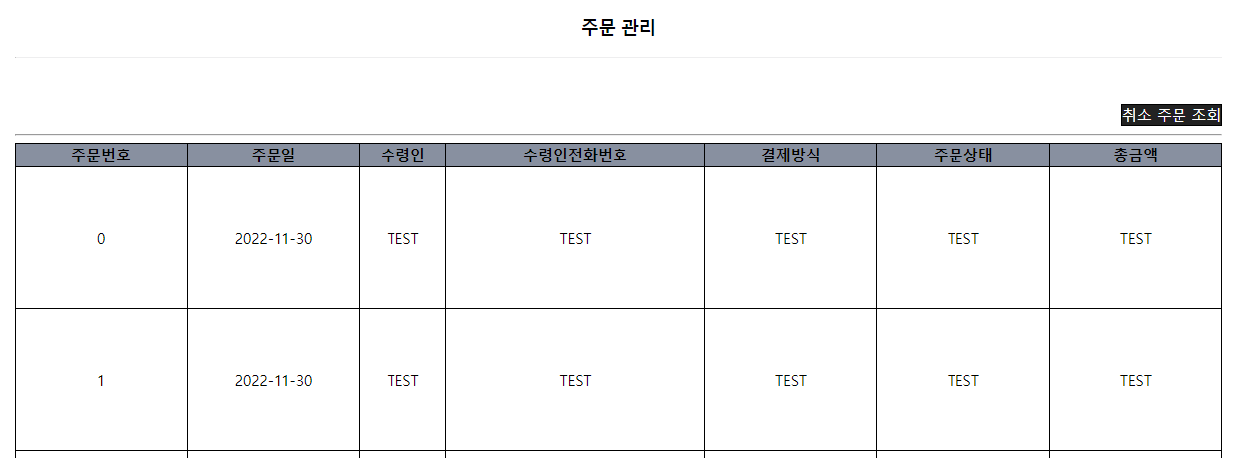
Enjoy your stylish business and campus life with BIZCAM

Slide 9
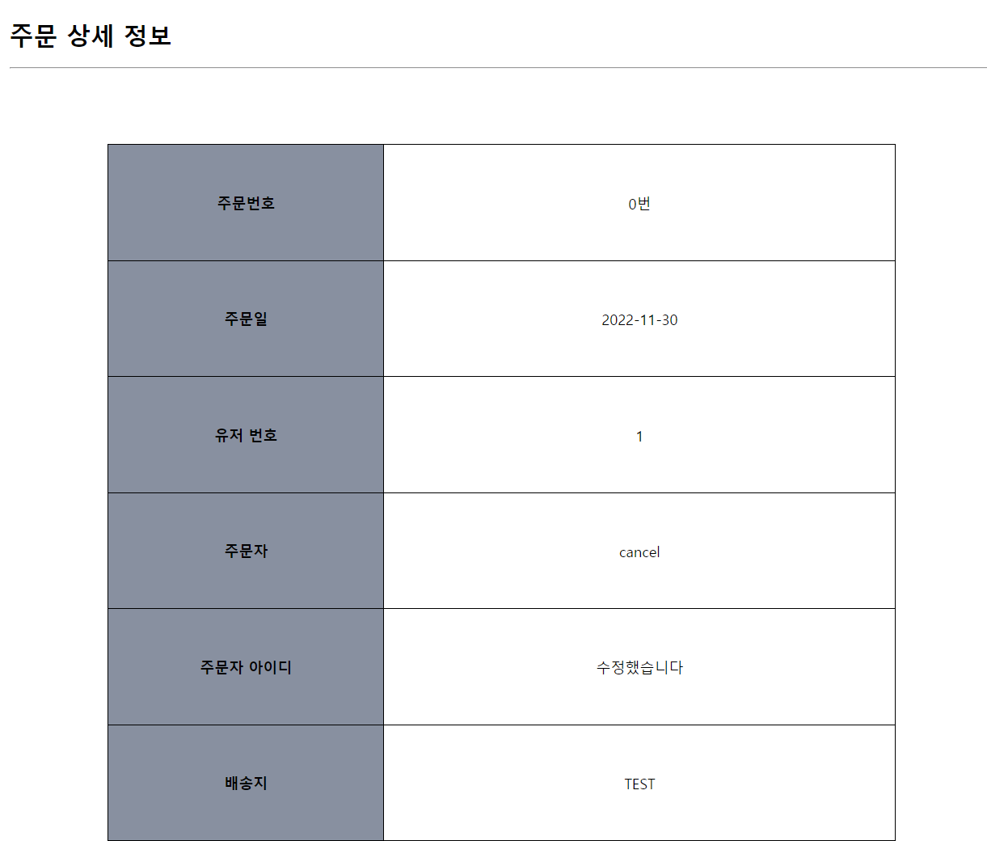
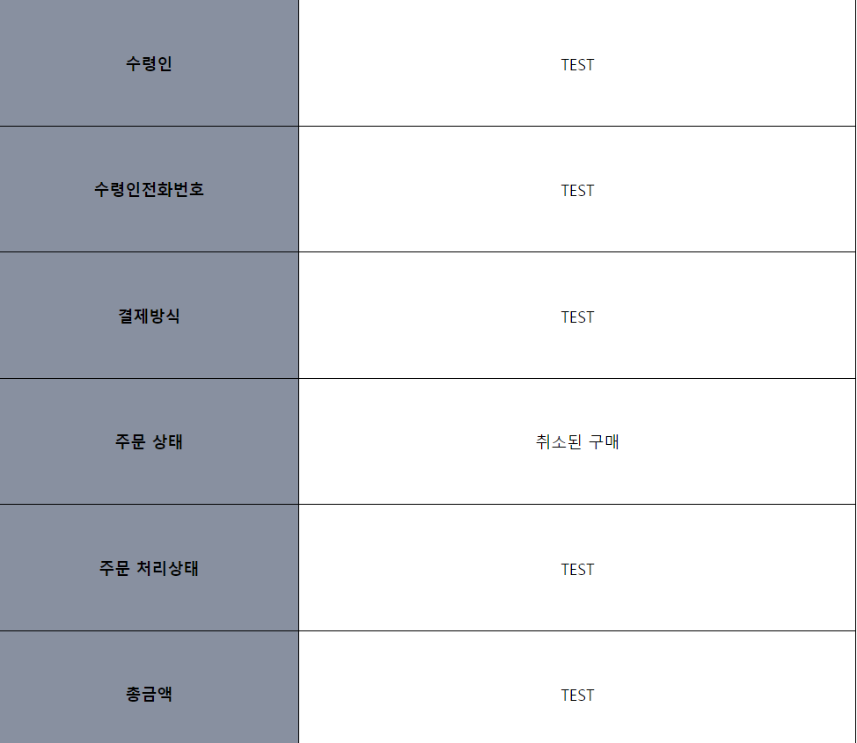
Enjoy your stylish business and campus life with BIZCAM

Slide 10
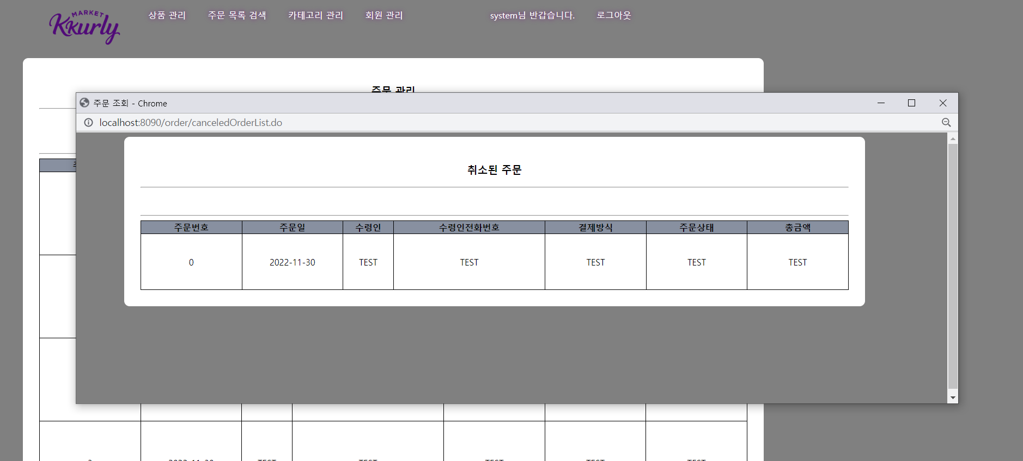
Enjoy your stylish business and campus life with BIZCAM

Slide 11
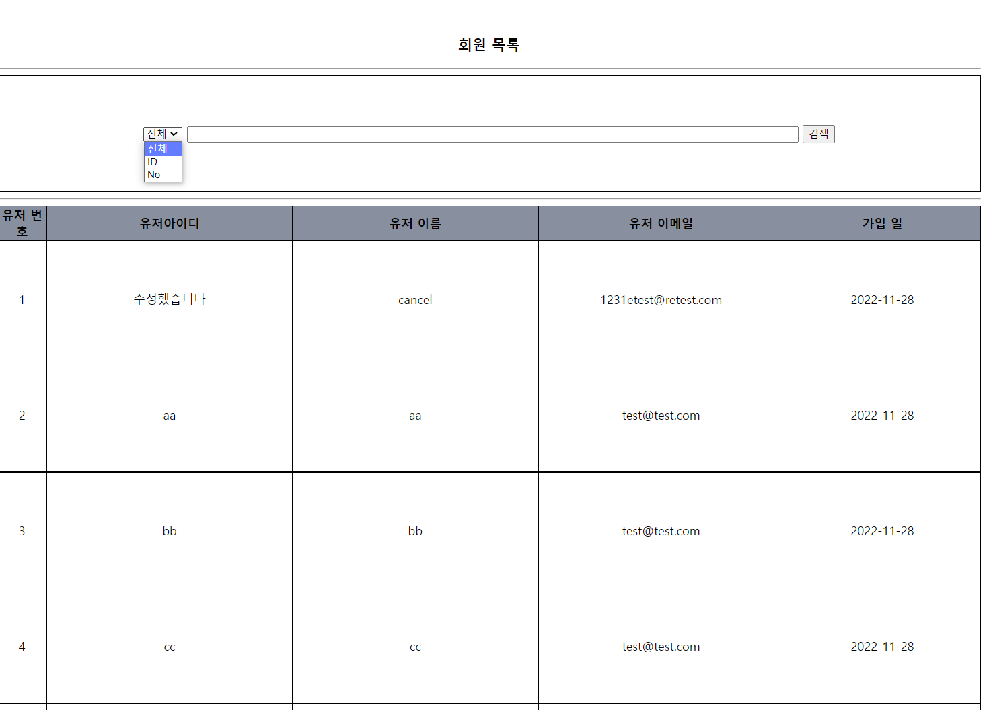
Enjoy your stylish business and campus life with BIZCAM

Slide 12
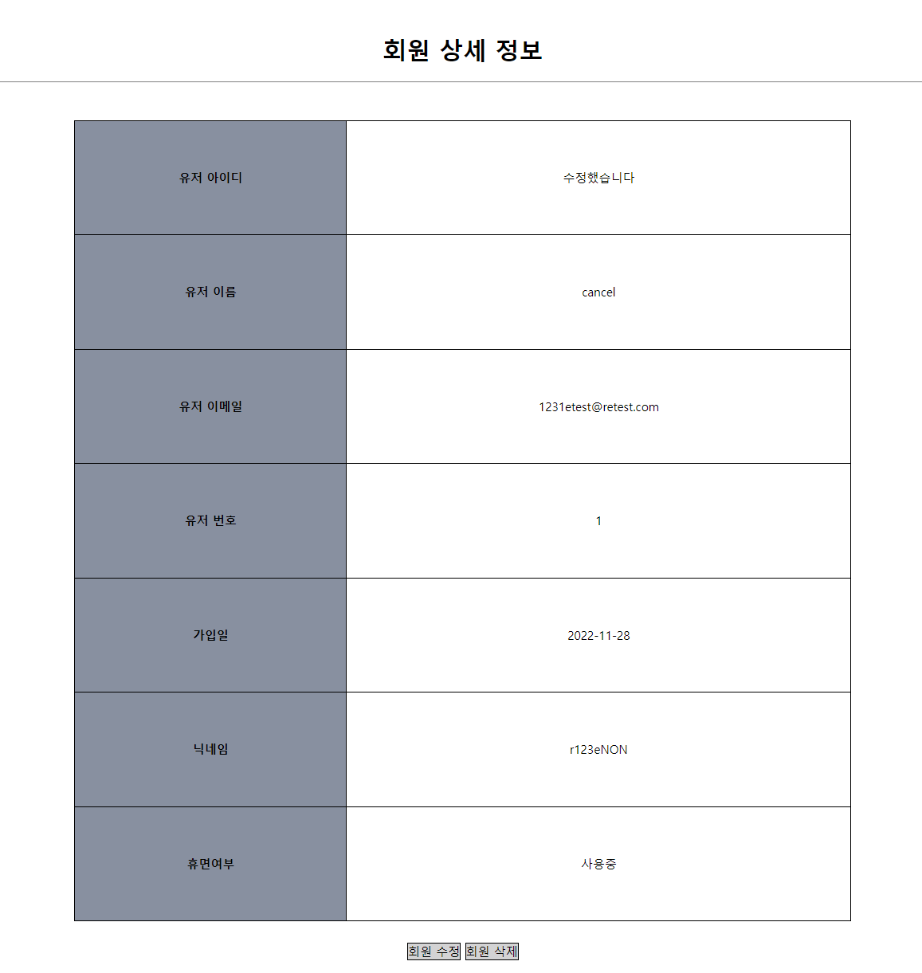
Enjoy your stylish business and campus life with BIZCAM

Slide 13
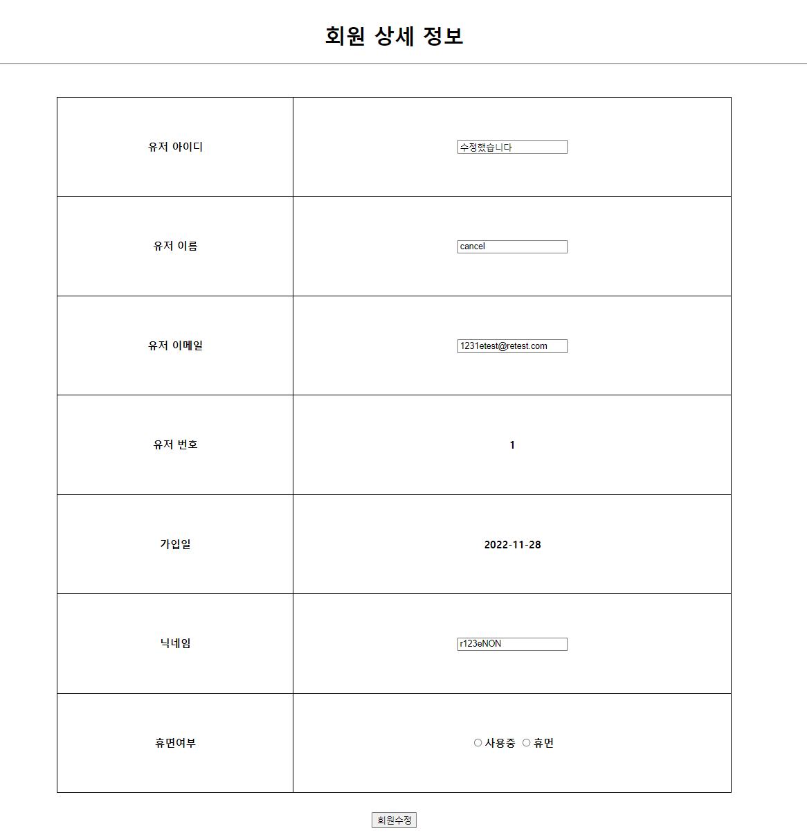
Enjoy your stylish business and campus life with BIZCAM

Slide 14
Enjoy your stylish business and campus life with BIZCAM

